Slide 1
PRELIMINARY REPORT / 2026
CONNECTED TOOLCHAIN
Best Tools for
Program Development
PLAN
CODE
↗
An Analysis of Modern Software Engineering
Toolchains & Project Traceability
TEST
BUILD
Șerban Alexandru-Cristian-George
Tools for Program Development – Preliminary Report
SHIP
Traceability • Reproducibility • Feedback
Notes:
Introduce this as an analysis of connected toolchains rather than a ranking of isolated applications. Preview the three recurring themes: delivery speed, reproducibility, and traceability.

Slide 2
01 / FOUNDATIONS
Introduction & SDLC Foundations
A modern toolchain connects people, code, automation, and evidence across the software lifecycle.
01
Requirements
02
Author
03
Build
04
Verify
05
Deploy
Issues & scope
IDE & source control
Dependencies & artifacts
Tests & quality gates
Release & operations
THE SHIFT
WHY IT MATTERS
OBJECTIVE
From isolated coding to pipelines
Quality, speed, maintainability
One cohesive, reproducible system
Teams rely on coordinated workflows instead of stand-alone editors and manual handoffs.
Tool choices shape feedback time, consistency, collaboration, and long-term change cost.
Connect requirements to code, tests, and releases so project progress can be verified.
Notes:
Walk the audience through the SDLC from requirements and authoring to build, verification, and deployment. Stress that the toolchain is only useful when each stage leaves evidence that the next stage can consume.

Slide 3
02 / CONTEXT
Historical Evolution of Development Tools
Each era adds abstraction and automation while preserving the value of clear, inspectable workflows.
1970s
1980s–1990s
2000s–2010s
2020s–present
Command line & Unix
Integrated environments
Open source & containers
Cloud-native & AI-assisted
Modular CLI utilities: vi, ed, cc
Editors, compilers & debuggers brought together
SVN/CVS → Git (2005): every clone stores the full repository history
Declarative CI/CD and LSP-powered tooling
make (1976) automates dependency-aware builds
RCS / CVS and later SVN use a centralized model
Docker (2013) makes environments portable
AI-assisted coding joins automated workflows
Composable tools
Integrated workflow
Full local history
Connected automation
From local commands → integrated tools → distributed collaboration → continuously verified delivery
Notes:
Explain the progression from small Unix utilities and make to integrated IDEs, centralized version control, then Git’s distributed model and Docker containers. With Git, every clone contains repository history, which supports offline work and broad collaboration.

Slide 4
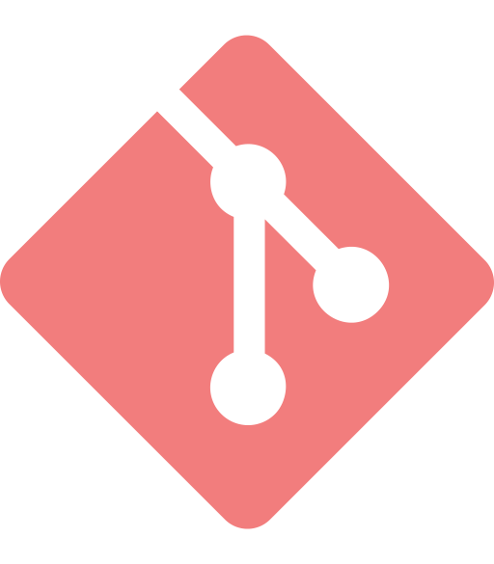

03 / CREATION & COLLABORATION
Core Tool Categories · Part 1
Choose an authoring environment that fits the language and workflow; use version control as the shared history.
01 / CODE AUTHORING
02 / VERSION CONTROL
Integrated Development Environments
Git keeps the history distributed
Visual Studio Code
LIGHTWEIGHT + MODULAR
LSP decouples the editor from language servers for completion, diagnostics, and navigation.
Local branches
Integrity
Audit trail
Parallel work
Content hashes
Reviewable change
JetBrains ecosystem
DEEP LANGUAGE INTELLIGENCE
HOSTING + COLLABORATION
IntelliJ, CLion, and Rider emphasize semantic analysis and refactoring.
GitHub
GitLab
Visual Studio
ENTERPRISE-GRADE IDE
Pull requests
Issues & Actions
Merge requests
Issues & GitLab CI
Integrated debugging for C# / .NET and substantial C++ solutions.
Best practice: review changes before merging to the main branch.
Notes:
Point out that VS Code’s language-server support follows the Language Server Protocol, separating editor features from language-specific analysis. Git preserves history locally, while GitHub and GitLab add shared reviews, issues, and automated workflows.

Slide 5
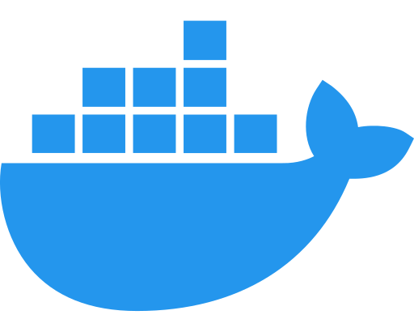



04 / BUILD, OPERATIONS & QUALITY
Core Tool Categories · Part 2
Build tools make outputs repeatable; containers reduce environment drift; QA tools shorten the feedback loop.
01
Build & packages
02
Containers & CI/CD
03
Testing & QA
Repeatable dependency graphs
Consistent environments, automated flow
Catch regressions and risky patterns
C / C++
ENVIRONMENT
UNIT TESTS
CMake
Docker
·
Podman
xUnit
·
pytest
JVM
CI PLATFORMS
INTEGRATION / API
Gradle
·
Maven
GitHub Actions
Postman
PACKAGES
PIPELINE AUTOMATION
STATIC + SECURITY GATES
npm
·
Cargo
·
NuGet
GitLab CI
SonarQube
Pin and lock dependencies
Build → test → deliver
Unit → API → security gates
Notes:
Describe build generators and package managers as the foundation for repeatable builds, and Docker as a way to reduce environment drift. The QA path shown is unit tests with xUnit or pytest, integration/API checks with Postman, and static/security gates with SonarQube.

Slide 6
05 / DECISION SUPPORT
Toolchain Comparison Matrix
The strongest stack is the one that covers the lifecycle with minimal friction and visible evidence.
CATEGORY | LEADING TOOLS | CORE STRENGTH | SDLC STAGE
Code authoring | VS Code JetBrains Visual Studio | Smart completion, refactoring, debugging | Implementation
Version control | Git GitHub GitLab | Branching, review workflows, audit trail | All SDLC phases
Build & dependencies | CMake Gradle Cargo npm | Reproducible builds and dependency control | Build
Environment parity | Docker Podman | Process isolation; consistent dev/test/prod | Testing & deployment
Automated CI/CD | GitHub Actions GitLab CI | Automated checks and rapid feedback | Verification & delivery
Testing & quality | Postman SonarQube xUnit pytest | Regression detection, API checks, code health | Quality assurance
Notes:
Use this matrix to compare tools by the SDLC stage they support and the evidence they produce. No single product is best for every project; prefer a compatible stack with low friction and reproducible outcomes.

Slide 7
06 / PROJECT GOVERNANCE
Traceability in Practice: GitHub Workflow
Follow one ML classification feature from issue definition to a versioned release.
ILLUSTRATIVE ISSUE-TO-RELEASE WORKFLOW
Issue #12
→
Branch + commit
→
Pull Request #15
→
GitHub Actions
→
Merge + release
Feature spec: ML.NET ticket classifier
feature/ml-ticket-prediction
Targets main · Closes #12
Tests + linter on push
Tag v1.0.0
Commit convention: feat(ml): add ticket priority prediction (refs #12)
01
Interoperability
02
Reproducibility
03
Velocity & feedback
CLI, webhooks, and APIs should connect the tools without manual copying.
Lock dependencies and standardize environments so runs behave consistently.
Fast tests, linting, and quality gates catch defects close to the change.
Course brief: project traceability is explicitly emphasized in the final score; GitHub or a similar VCS is recommended.
Notes:
This is an illustrative workflow for a user-authentication feature: Issue #12 defines the requirement; branch feature/ml-ticket-prediction contains the work; the commit message references the issue; PR #15 targets main and uses “Closes #12”; GitHub Actions runs tests and linting on pushes and pull requests; after merge, tag the release as v1.0.0. The commit and PR syntax creates links between the requirement, review, automated checks, and release history.

Slide 8
07 / PROJECT PLAN
Our Proposed Project Stack
Selected Baseline for the Semester Project — a practical starting point for Report 1.
GitHub
VS Code
Docker
GitHub Actions
Visual Studio
VCS + ISSUE TRACKER
AUTHORING + DEBUGGING
REPRODUCIBLE ENVIRONMENT
CONTINUOUS INTEGRATION
→
→
→
Issues link the feature request to branches, pull requests, workflow runs, and release evidence.
Use LSP-aware editing and a language-specific debugger matched to the project’s language and framework.
Pin the runtime and dependencies so local development and CI use a consistent environment.
Run the build, tests, and linter automatically on push and pull_request events.
Issue #12 → PR #15
feature/ml-ticket-prediction
Dockerfile
.github/workflows/ci.yml
TRACEABILITY TRAIL
Issue #12 → feat(ml): add ticket priority prediction (refs #12)→ PR #15 → green CI run → tag v1.0.0
Baseline principle: integrated tools, reproducible runs, and evidence that can be inspected during grading.
BEST TOOLS FOR PROGRAM DEVELOPMENT
8
Notes:
This is the proposed baseline to carry into Report 1: GitHub for Git hosting, issues, and pull requests; VS Code or Visual Studio for authoring; Docker for a consistent environment; and GitHub Actions for CI. The stack is intentionally modest, but it leaves a visible audit trail from issue to release tag.

Slide 9
08 / WRAP-UP
Conclusions & References
The best tools work as an integrated system: each reduces friction and creates evidence for the next stage.
KEY TAKEAWAYS
REFERENCES
01
Think ecosystem, not product
01
Software Testing Help
“Top 20+ Best Software Development Tools”
A connected toolchain is more valuable than isolated tools used without shared workflow.
softwaretestinghelp.com/software-development-tools/
02
Guru99
02
Start with version control
“24 Best Software Development Tools Ranking”
guru99.com/software-development-tools.html
Adopt Git and a hosted collaboration workflow from day one to preserve change history.
03
Chacon, S. & Straub, B.
Pro Git. Apress.
03
Automate the evidence
git-scm.com/book
Repeatable builds, tests, reviews, and releases help demonstrate quality and accountability.
04
Sommerville, I.
Software Engineering, 10th Edition. Pearson.
Pearson Education
Notes:
Conclude that the strongest toolchain is an integrated system, and that version control and automated evidence should be present from the first day. Briefly acknowledge the two online tool roundups and the Pro Git and Sommerville references that informed the report.

